Slide 1
Detection of Anomalous Behaviour in an Industrial Robot
Machine Learning in Applications(A.Y. 2025/2026) - Politecnico di Torino
Shamim Zare
Fabio Marchese
Geremia Feira
Emanuele Bernacchi
Presented by:
s327306
s349514
s342726
s347744

Slide 2
Materials and Methods
Notes:
Good morning, I'm Fabio and I will walk you through the methodology we adopted for this project, starting from data management up to the evaluation protocol.

Slide 3
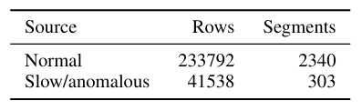
Dataset Analysis
OVERVIEW
Dataset Composition
Dataset Properties
• Temporal Unit: Each row corresponds to one timestep.
• Dimensionality: 85 numerical features were used for the analysis.
• Action Segmentation: Executions are segmented at changes of the robot action to form homogeneous runs.
Notes:
Let’s move to our preprocessing pipeline, which consists in four strict steps.
Step one focused on cleaning missing values.
We applied linear interpolation strictly within each individual run and by using forward and backward filling we were able to resolve any remaining missing values at the edges.
Step two is the data split.
We performed the split strictly at the run level. This is a critical detail because it completely avoids data leakage. Indeed, by doing so, we're ensuring that two overlapping or temporarlly adjacent window from the same action cannot appear in both training and testing. Lastly, as it can be noticed we have used 60% of the dataset for the training set and the 20% for both validation and test sets.
Step three involved feature scaling.
Here we used StandardScaler as our primary protocol, fitting it only on the normal training data to preserve the integrity of our evaluation.

Slide 4
Pipeline: Preprocessing & Data Split
Step 01
Step 02
Step 03
Cleaning Missing Values
Run-Level Split
Feature Scaling
• Linear interpolation applied within each individual run.
• Forward & backward fill used to resolve remaining edge anomalies.
• Splitting performed strictly at the run level to completely avoid data leakage.
• Training = 60% | Validation = 20% | Test = 20%
• StandardScaler used as the primary normalization protocol.
• Fitted only on normal training data to preserve evaluation integrity.
Notes:
Let’s move to our preprocessing pipeline, which consists in four strict steps.
Step one focused on cleaning missing values.
We applied linear interpolation strictly within each individual run and by using forward and backward filling we were able to resolve any remaining missing values at the edges.
Step two is the data split.
We performed the split strictly at the run level. This is a critical detail because it completely avoids data leakage. Indeed, by doing so, we're ensuring that two overlapping or temporarlly adjacent window from the same action cannot appear in both training and testing. Lastly, as it can be noticed we have used 60% of the dataset for the training set and the 20% for both validation and test sets.
Step three involved feature scaling.
Here we used StandardScaler as our primary protocol, fitting it only on the normal training data to preserve the integrity of our evaluation.

Slide 5
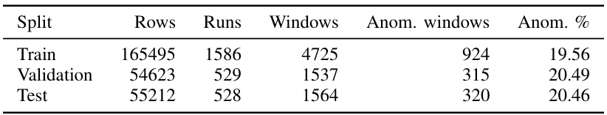

Pipeline: Windowing
STEP 04
Split & Windowing Summary
Window Management
• Window length = 64
• Stride = 16
• Anomalous if at least 10% of internal timesteps are anomalous
Notes:
Finally the fourth step: Window Management.
To capture temporal dynamics, we extracted temporal windows with a length of 64 timesteps and a stride of 16. Then According to our labeling strategy, a window is classified as anomalous if at least 10% of its internal timesteps represent anomalous behavior.
In conclusion, the table here summarizes the final distribution of our data across the splits, maintaining a consistent anomaly proportion of around 20% in both the validation and test sets
Per la stessa proporzione nel codice abbiamo usato il flag stratify by level che sta in src\am01\data\windowing.py

Slide 6
Evaluated Models
Baseline
Classical
Neural
Neural
Adversarial
PCA
Isolation Forest
MLP AE
Conv1D AE
AAE MLP
• window flattened from 64 x 85 to 5440 dimensions
• 95% of variance kept
• Non-neural classical anomaly detector.
• Uses 7 statistical features (mean, std, min, max, energy, mean of temporal differences and std of temporal differences).
• contamination = ‘auto’
• Standard Autoencoder.
• Hidden layers of 256 and 128 units.
• Latent dimension bottleneck set to 16.
• Convolutional Autoencoder architecture.
• Arranges input as [channels, time].
• kernel_size = 5
• Adversarial Autoencoder model.
• Adds a latent discriminator against N(0, I)
Notes:
Then, with the data prepared, we evaluated five different models.
First, a baseline based on PCA, where we flattened the windows while retaining the 95% of the variance.
Second, the Isolation Forest, a non-neural classical anomaly detector.
Here, to have a more macroscopical approach we extracted 7 statistical features per window resulting in 595 statistical features.
Next, we evaluated deep neural models, starting with a standard MLP Autoencoder with hidden layers of 256 and 128 units, and a latent dimension bottleneck set to 16.
We also tested a mono-dimensional convolutional Autoencoder, which arranges the input as channels over time. The idea was to try to preserve the local temporal structures by applying 1D convolutions over the time dimension.
Finally, the core model of the research: the Adversarial Autoencoder (AAE) MLP. This architecture adds a latent discriminator trained against a standard Gaussian distribution, and training alternates between reconstruction and adversarial updates.
An important note is that we used the reconstruction error as the anomaly score for all the models except for the isolation forest of course.

Slide 7
Training & Evaluation Protocol
Training
Evaluation
Deep Model Optimization
Metrics & Validation
Official Configuration: lr=1e-3 | batch_size=128 | weight_decay = 1e-5 | window length=64 | stride=16 | StandardScaler | MSE | seed=42
Training is based exclusively on normal sequences
Threshold-Free: ROC-AUC, PR-AUC.
Threshold Selection: Best F1-Score calculated on validation
Key Diagnostics
Notes:
To conclude my part, let's look at the Training and Evaluation Protocol.
Regarding the training, the official configuration is the following indicated on the slide.
Therefore deep models used it and were optimized exclusively using normal sequences from the training set, utilizing validation data for early stopping to prevent overfitting and select the best epochs.
For validation and metrics, we ranked the models using threshold-free metrics like global ROC-AUC and PR-AUC. Whereas for threshold selection, we calculated the best F1-Score on the validation set, and then applied that threshold to the test set. Finally, we tracked key diagnostics such as precision, recall, false alarms per run, and detection delay.
I will now hand over to my colleague Geremia who will explain to you more about our results.
Per le key diagnostic, nel codice sono in src\am01\evaluation\metrics.py, sarebbe la funzione event metrics

Slide 8
Results and Discussion
Notes:
Good morning, I'm Geremia and I will guide you through the official quantitative results of our project, starting with our baseline benchmark: the Main MSE Protocol.

Slide 9
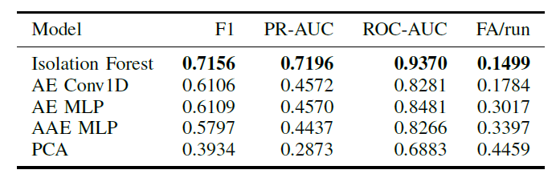
MSE-based Comparison
Under the MSE protocol, Isolation Forest achieves the best overall performance, outperforming AE, AAE, and PCA.
Notes:
As you can see on this slide, under our official protocol utilizing the standard Mean Squared Error loss, we encountered a highly compelling paradox. A classical, non-parametric statistical model—Isolation Forest—substantially outperformed our deep learning architectures, anchoring the highest baseline performance with a PR-AUC of 0.7196 and an F1-score of 0.7156.
The two neural reconstruction models based on MSE achieved significantly lower PR-AUC, settling around 0.45. This suggests that the anomaly signal in our KUKA dataset is expressed as a relatively separable pattern across channels, which a partition-based ensemble can exploit directly without the need for complex neural reconstructions.

Slide 10
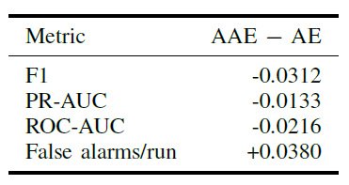
AAE vs AE
Direct Comparison
Same windowing
Same backbone and reconstruction loss
Adversarial latent space is the only difference
AAE showed no improvement over AE
A single Gaussian prior may fail to capture multimodal robot behavior
Notes:
Moving on this next slide, let's address the core experiment of this project: the direct comparison between the plain AE and the Adversarial Autoencoder. Both models share the exact same windowing, backbone, and reconstruction loss; the only conceptual difference is the adversarial latent-space regularization.
As summarized in the table, the AAE did not improve upon the AE. The delta is strictly negative for F1, PR-AUC, and ROC-AUC, and positive for false alarms, meaning the AAE produced more false alarms per run. This proves that enforcing a Gaussian latent prior does not automatically help. A plausible explanation is that normal robot behavior is multimodal because different actions induce different temporal regimes. A single isotropic Gaussian prior may fail to capture this multimodal complexity, restricting the model's effectiveness.

Slide 11
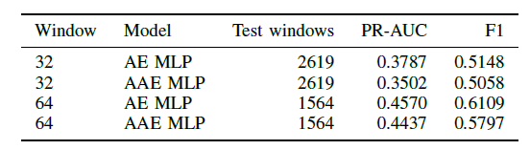
Impact of Window Length
Effect of temporal context
Increasing the window length (32 → 64) improves both AE and AAE
Longer temporal context benefits anomaly detection.
AE consistently outperforms AAE at both window lengths.
w=128 was excluded due to too few test windows and different anomaly prevalence.
Notes:
Then, we analyze how the window length materially changes the evaluation problem. When we compare performance at 32 and 64 steps, we see that increasing the temporal context improves both models. This confirms that a longer temporal horizon benefits anomaly detection because it captures the robot's kinematics more effectively. However, notice that the AAE remains below the standard AE at both window lengths.
We also explored larger windows like w=128, which showed higher apparent scores. However, we strictly excluded them from the official protocol because they left too few test windows and a different anomaly prevalence. Excluding it prevents us from over-interpreting an artifact of changing evaluation populations.

Slide 12
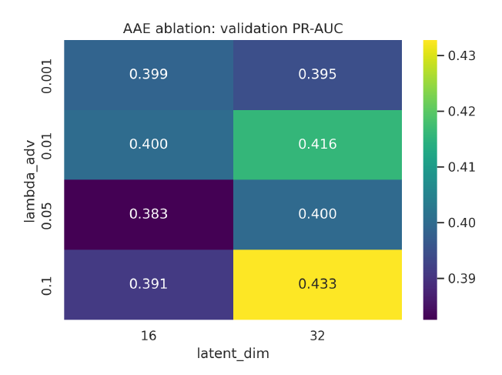
AAE hyperparameter ablation
Effect of latent dimension and adversarial weight
Limited sensitivity to hyperparameters
No configuration outperforms the AE baseline
The limitation is likely due to the adversarial prior, not only hyperparameter selection
Notes:
To ensure our negative findings weren't just the result of a bad configuration, we performed a thorough ablation study over the AAE hyperparameters, varying the latent dimension and the adversarial weight lambda{adv}.
As the heatmap illustrates, the validation PR-AUC shows a very limited sensitivity to these hyperparameters. Our best configuration improved over the default AAE only slightly, but completely failed to close the gap to the plain AE baseline. This confirms that the limitation is likely due to the structural constraint of the adversarial prior itself, rather than a mere failure of hyperparameter tuning.

Slide 13
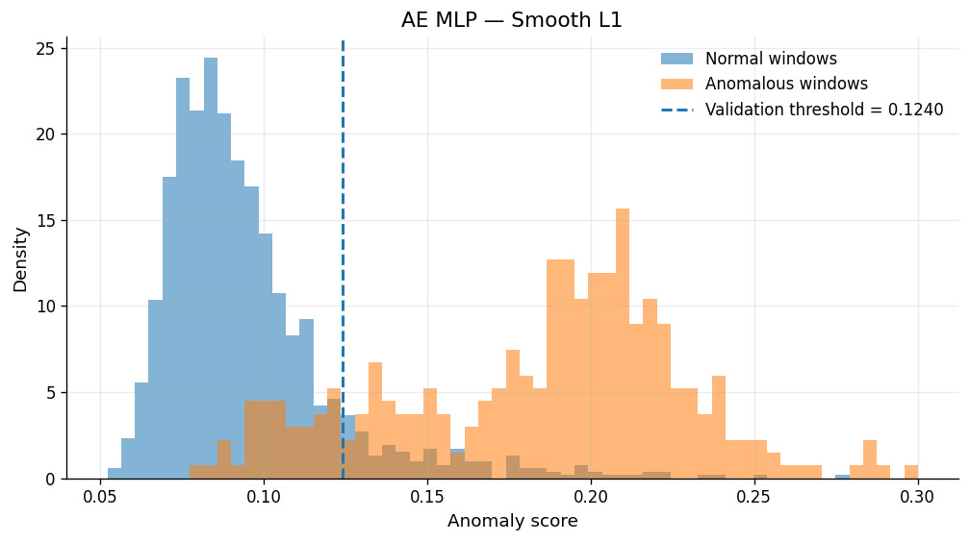
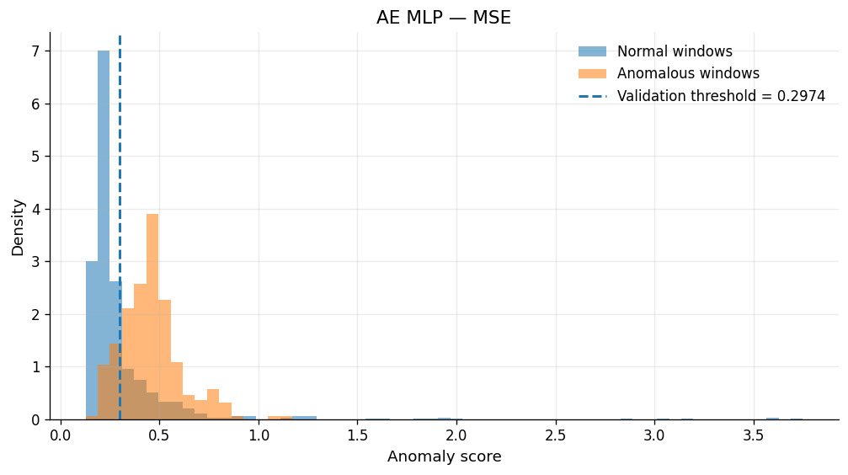
Effect of Robust Reconstruction Loss
Smooth L1 loss is the key factor driving the improvement, making reconstruction-based models more robust to outliers.
Peak performance achieved with an exceptional PR-AUC of 0.7634.
Notes:
The most crucial improvement of our project comes from rewriting our reconstruction loss strategy, and these two plots perfectly illustrate why.If we look at the right graph, standard MSE penalizes large residuals quadratically. This means the model gets completely dominated by high-frequency sensor noise on a few channels, forcing the normal and anomalous test distributions to heavily overlap. You can see how the validation threshold at 0.2974 is trapped in a zone that inevitably triggers massive false alarms.
By switching to Smooth L1 loss—shown on the left—which behaves linearly for large errors, we completely decoupled the model from outlier noise. The normal distribution tightly shrinks toward zero, allowing our pipeline to isolate a clean validation threshold at 0.1240.
This visual separation is precisely what drove our plain AE MLP to its peak PR-AUC of 0.7634, successfully outperforming our strong Isolation Forest baseline. The AAE improved too, but crucially, it still remained below the plain AE due to the Gaussian constraint we discussed. Ultimately, this shifts our entire narrative: the initial failure of deep architectures was not a structural limitation of Autoencoders, but a mathematical flaw of the MSE loss.
That concludes my part of the presentation. I will now hand over to Emanuele, who will take you through our final conclusions.

Slide 14
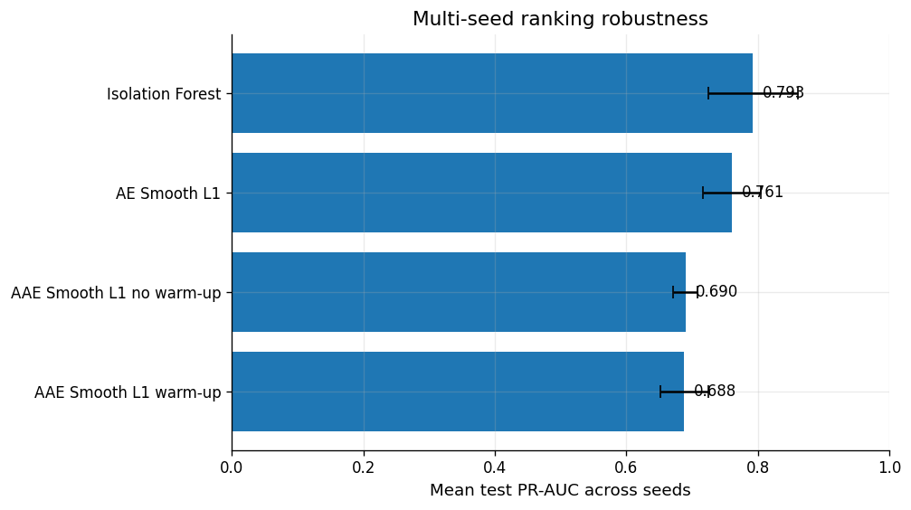
Multi-seed stability
Isolation Forest gives the strongest mean PR-AUC across seeds.
AE + Smooth L1 remains very competitive, with fewer false alarms.
AAE is consistently below AE: the gap is not just a bad seed.
0,793
0,761
0,690
IF mean PR-AUC
AE Smooth L1
AEE no warm-up

Slide 15
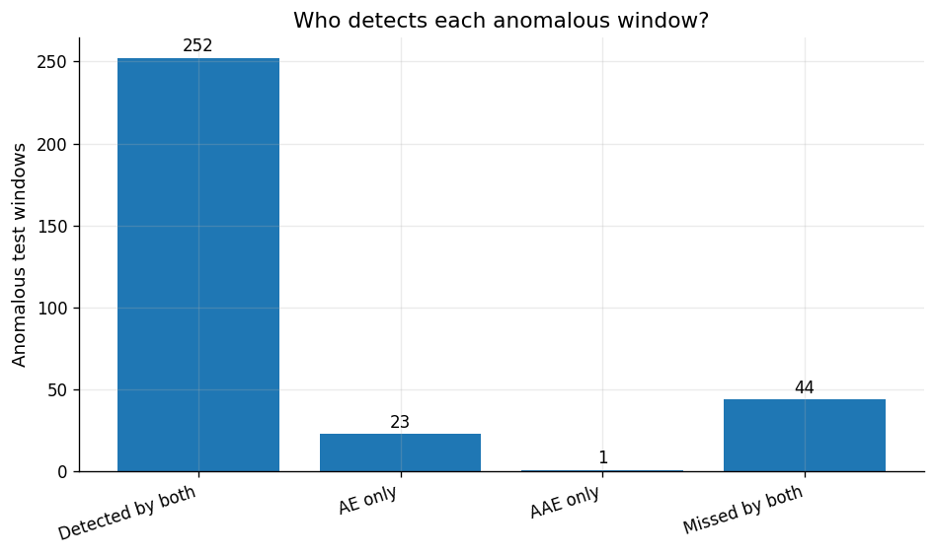
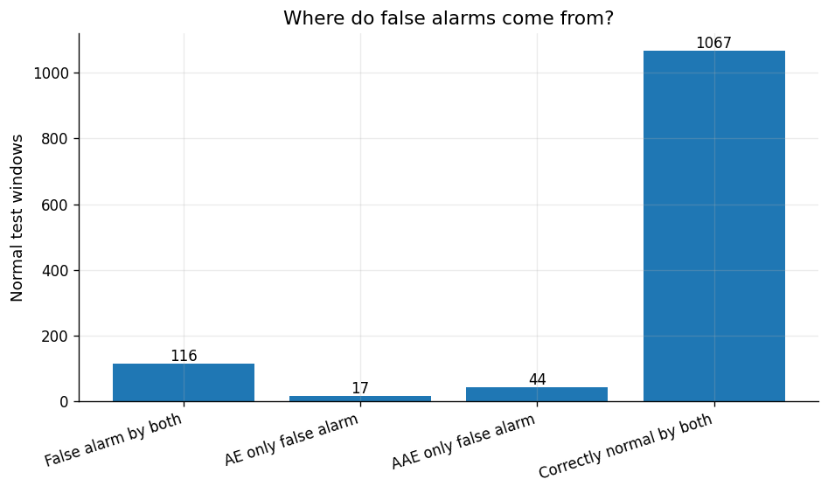
AAE diagnostics
AAE mostly detects a subset of the windows already detected by AE.
Latent norm, Mahalanobis distance and discriminator score have poor PR-AUC by themselves.
The discriminator regularizes the latent space, but it was never trained as a normal-vs-anomalous classifier

Slide 16
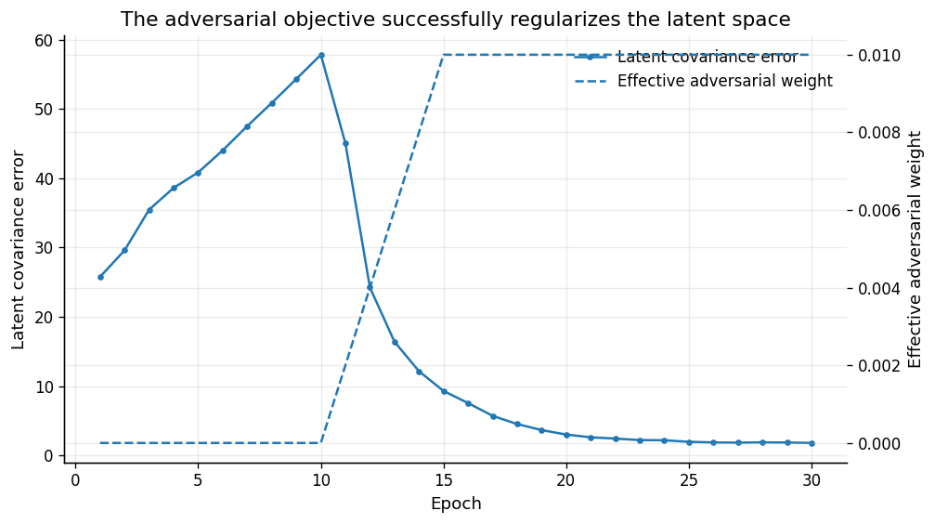
AAE warm-up
Optimization succeeds ≠ anomaly ranking improves
Warm-up reduces latent covariance error and stabilizes training, but test PR-AUC remains essentially unchanged.

Slide 17
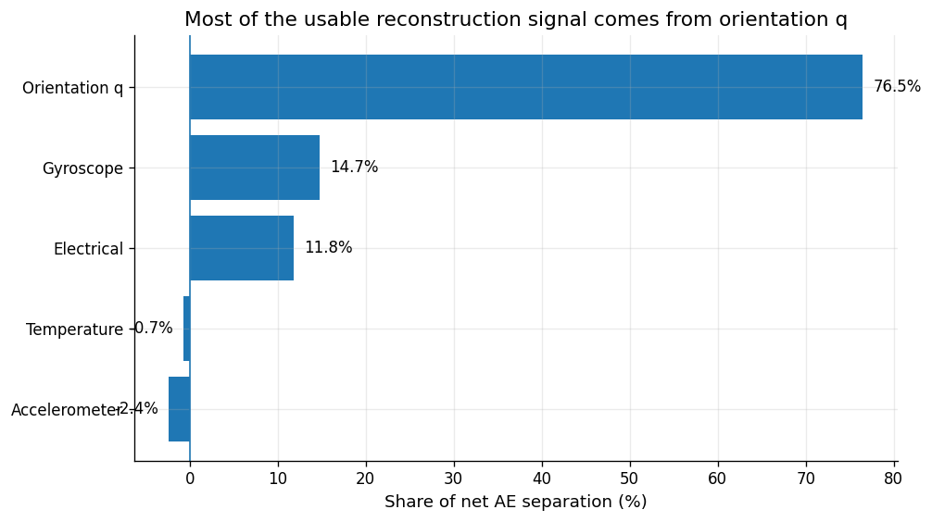
Per-feature analysis
WHAT HELPS
Orientation q and electrical features carry most of the separability.
WHAT HURTS
Several accelerometer channels are anti-informative: slow motion is often smoother and easier to reconstruct.
AEE EFFECTS
AAE improves q separation slightly, but degrades electrical, gyroscope and accelerometer families.

Slide 18
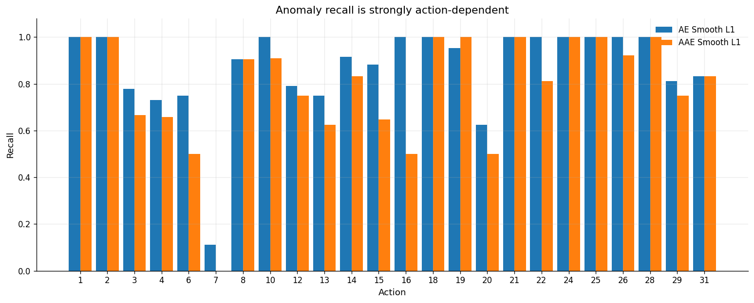
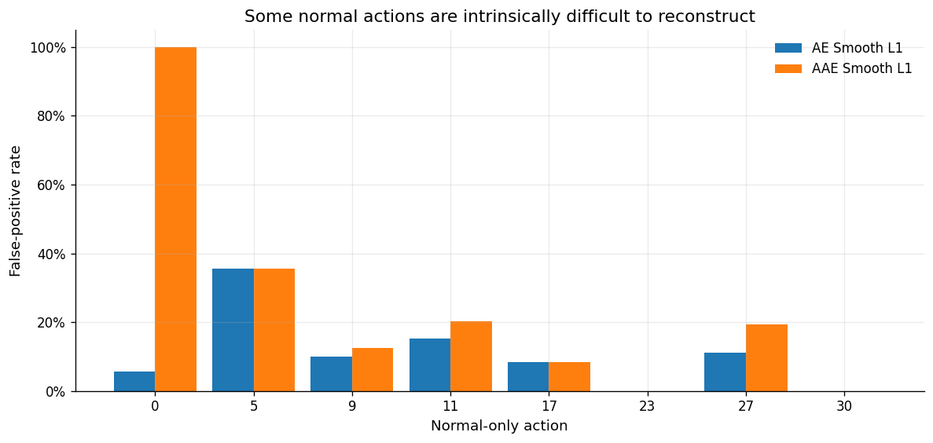
Per-action analysis
Some actions are almost perfectly detected; others, like action 7, are very weakly separated.
A single threshold assumes that the same score has the same meaning for every action.
This motivates action-conditioned thresholds or action-conditioned latent priors.

Slide 19
Discussion & conclusions
TAKEAWAY
The AAE regularizes the latent space, but the most valuable gains come from a robust, physically aligned anomaly score.
DISCUSSION
FUTURE WORK
Optimization works, task signal does not: warm-up makes the latent distribution closer to the Gaussian prior, but PR-AUC does not improve.
Normality is multimodal: actions and sensor families have different score distributions; a single isotropic prior can compress useful structure.
Score design dominates: Smooth L1 removes many false alarms while preserving most detections; robustness matters more than latent matching.
Action-conditioned thresholds / priors: calibrate false alarms per operating mode.
Feature-family weighted score: exploit q/electrical signal, clean weak temperature channels.
Hybrid detector: combine reconstruction error with statistical regime features.

Slide 20
Thank you for your attention!

